Slide 1
Welcome to MSDS 6371 Statistical Foundations Live Session 11, January 19, 2021
Announcements
Instructor: Dr. Martin Selzer
Office Hours (Schedule Appointment by Email)
Teaching Assistant is Michael Wang
My email martin.selzer@gmail.com and mselzer@mail.smu.edu
Remember, project is available in the files folder

Slide 2
Agenda Session 11
Breakout – Live Session Questions 25 Mins 25
Review Live Session Answers 55 Mins 80
Summary, Questions 10 Mins 90

Slide 3
UNIT 11
Residuals and Model Assessment
Simple Linear Regression Coefficient Interpretation after Log Transformation

Slide 4
Assumptions for Simple Linear Regression
Linearity
A straight line may be inadequate.
Outliers may bias estimates.
Constant Variance (Equal Spread)
Estimates (Betas) are still unbiased if assumption is violated.
Standard Errors are inaccurate, thus rendering tests and confidence intervals to be misleading.
Normality
Both the estimates and their standard errors are robust to non-normal distributions.
Similar to hypothesis testing, problems arise with long tails (outliers) and small sample sizes.
Violations will affect prediction intervals more than confidence intervals.
Independence
Lack of independence causes no bias in the estimates, although seriously affects standard errors. Need for more sophisticated models discussed NEXT SEMESTER in MSDS 6372.

Slide 5
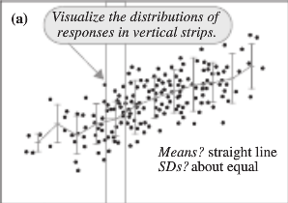
Model Assessment (Graphical)

Slide 6
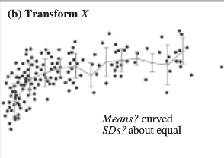
Model Assessment (Graphical)

Slide 7
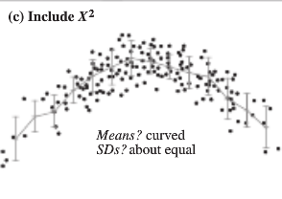
Model Assessment (Graphical)

Slide 8
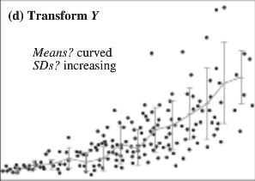
Model Assessment (Graphical)

Slide 9
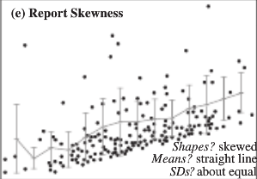
Model Assessment (Graphical)

Slide 10
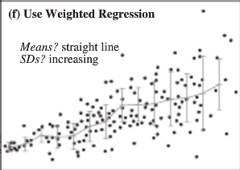
Model Assessment (Graphical)

Slide 11


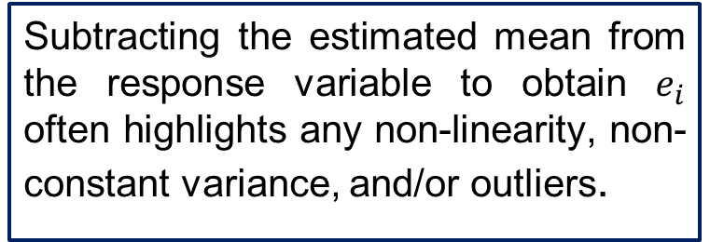

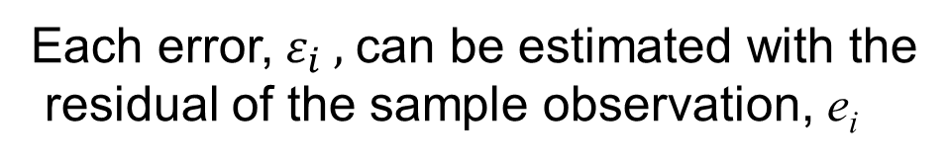


Residuals Analysis
$$Y_{i}= β_{0}+β_{1}X_{1_{i}}+ε_{i}$$
If the assumptions about the population are met, then:
$$ε_{i}\sim N(0,σ^{2})$$
Each error,${ ε}_{i} ,$ can be estimated with the
residual of the sample observation, e_{i}
$$Y_{i}= {\hat{β}}_{0}+{\hat{β}}_{1}X_{1_{i}}+e_{i}$$
Subtracting the estimated mean from the response variable to obtain $e_{i}$ often highlights any non-linearity, non-constant variance, and/or outliers.
Remember:
Residual = Observed - Expected
$$e_{i}=Y_{i}−{\hat{Y}}_{i}$$
$$e_{i}=Y_{i}−({\hat{β}}_{0}+{\hat{β}}_{1}X_{i})$$

Slide 12
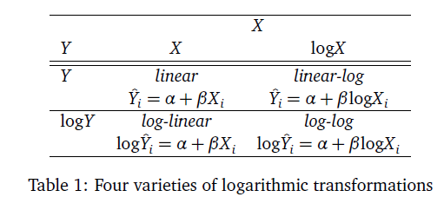
Log Transforms To Perform So Regression Assumptions Are Met

Slide 13
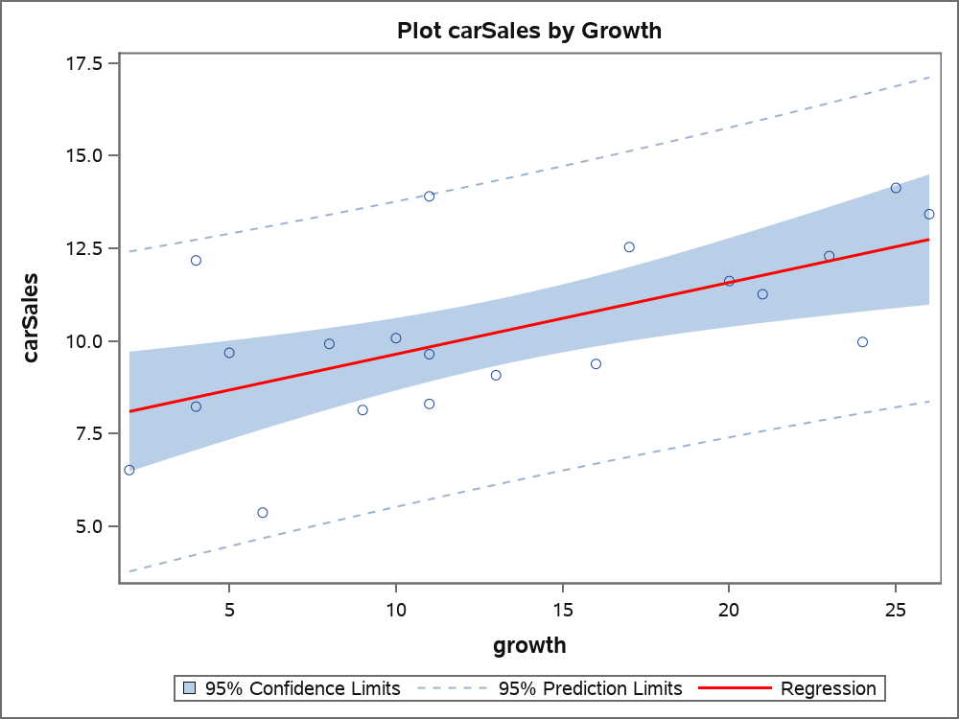
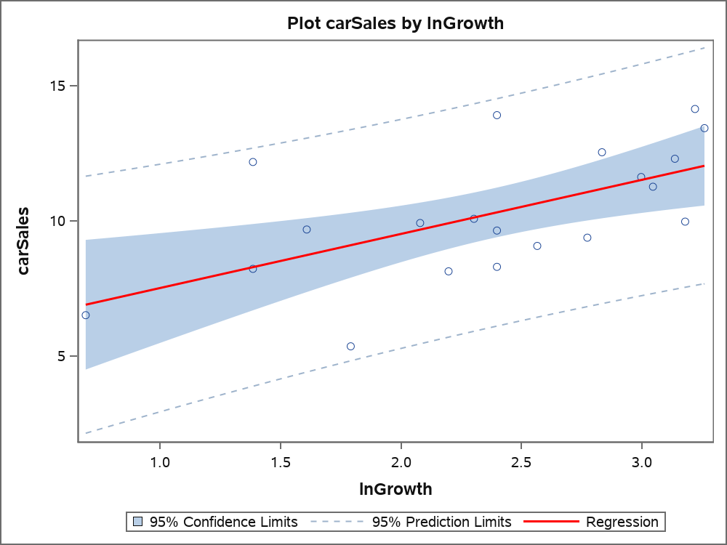
Investigate Car Sales by Economic Growth
Log X Model
proc sgplot data=carSales;
reg x=growth y=carSales/ clm cli
lineattrs=(color=red thickness=2);run;
proc sgplot data=carSales;
reg x=lnGrowth y=CarSales/ clm cli
lineattrs=(color=red thickness=2);run;
Looks like Heteroskedasticity in Model
Less Heteroskedasticity in Model

Slide 14
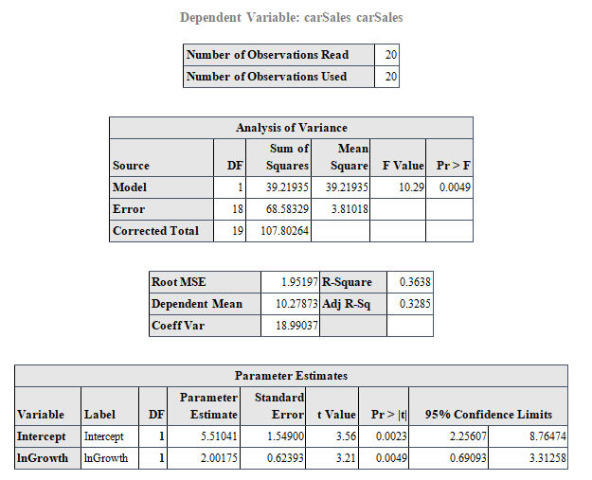
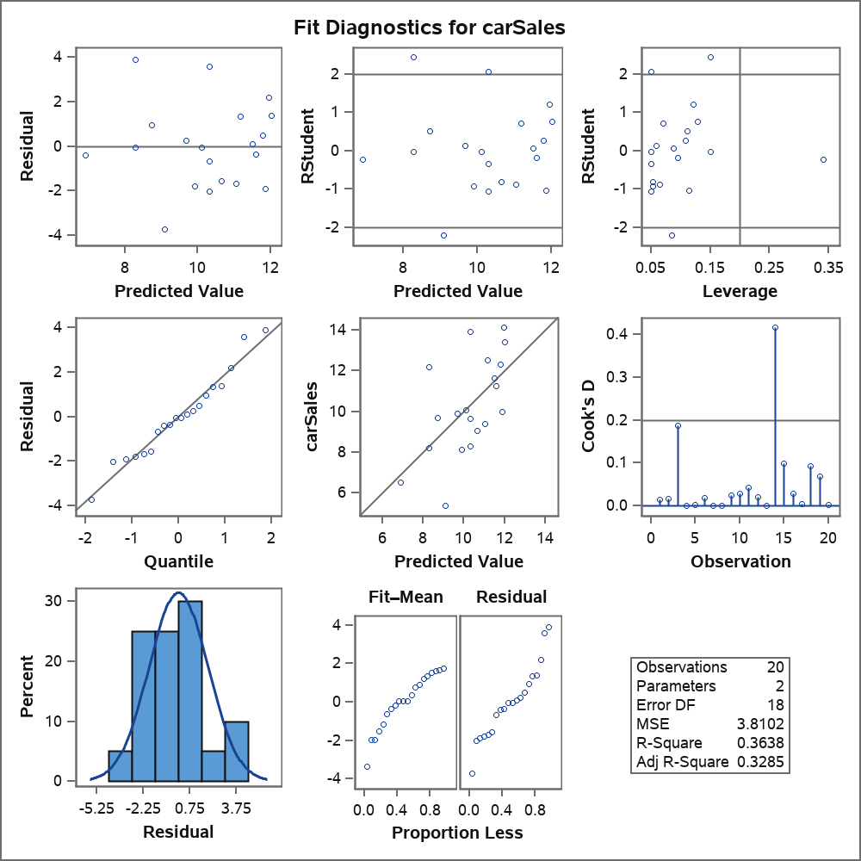
Model Results Car Sales by Economic Growth Using log of Growth

Slide 15
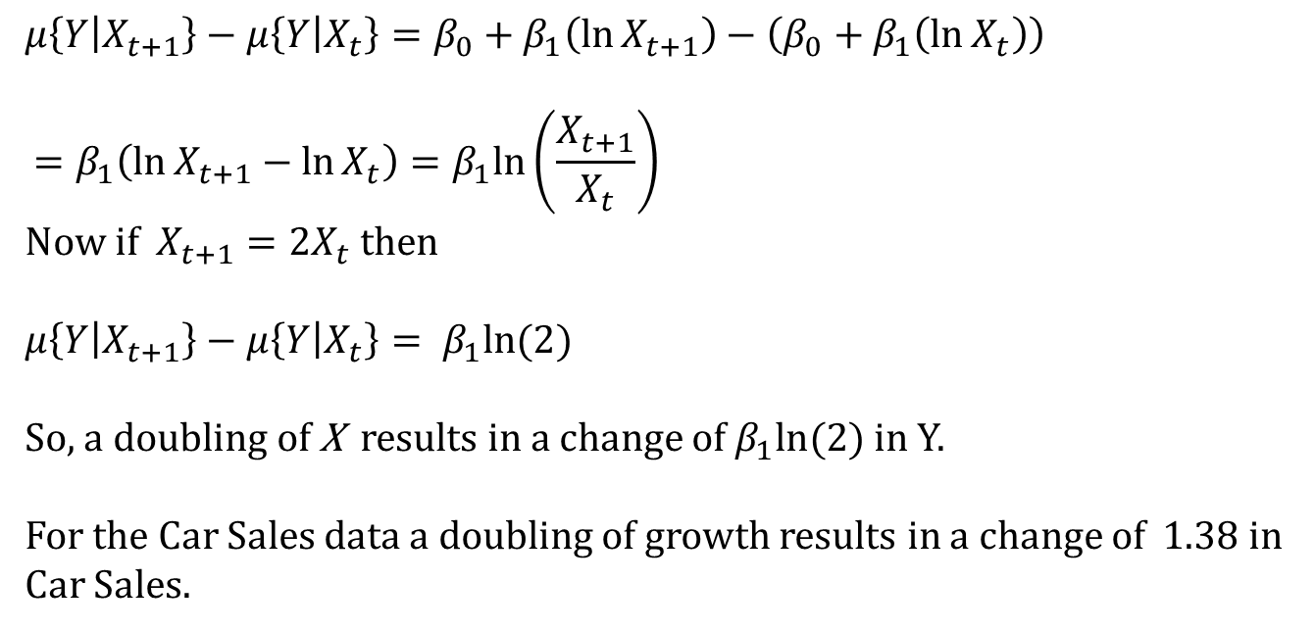
Interpretation of Regression Coefficient log x model
$$μ\left\{Y | X_{t+1}\right\}−μ\left\{Y | X_{t}\right\}=β_{0}+β_{1}\left(\ln{X_{t+1}}\right)−\left(β_{0}+β_{1}\left(\ln{X_{t}}\right)\right)$$
$$=β_{1}\left(\ln{X_{t+1}}−\ln{X_{t}}\right)=β_{1}ln\left(\frac{X_{t+1}}{X_{t}}\right)$$
Now if $X_{t+1}=2X_{t}$ then
$$μ\left\{Y | X_{t+1}\right\}−μ\left\{Y | X_{t}\right\}= β_{1}ln⁡(2)$$
So, a doubling of X results in a change of $β_{1}ln⁡(2)$ in Y.
For the Car Sales data a doubling of growth results in a change of 1.38 in Car Sales.

Slide 16

Another Model - Insulation and Voltage Data
First 19 Obs. Below
n = 76 in Entire Sample
In an industrial laboratory, under uniform conditions, 76 batches of electrical insulating fluid were subjected to constant voltages until the insulating property of the fluids broke down. Seven different voltage levels, spaced 2 kilovolts apart from 26 to 38 kV were studied. The measured responses were the times, in minutes, until breakdown.

Slide 17
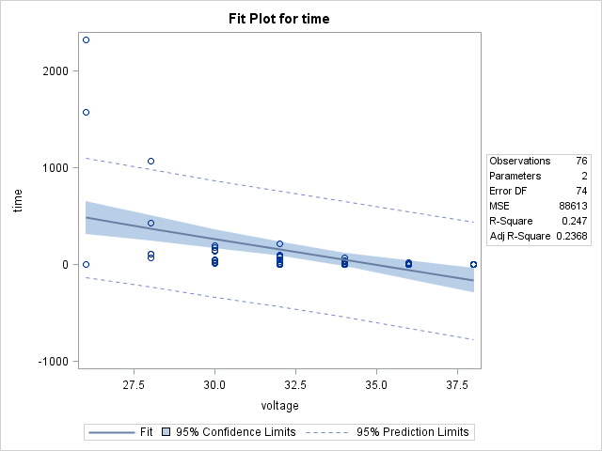
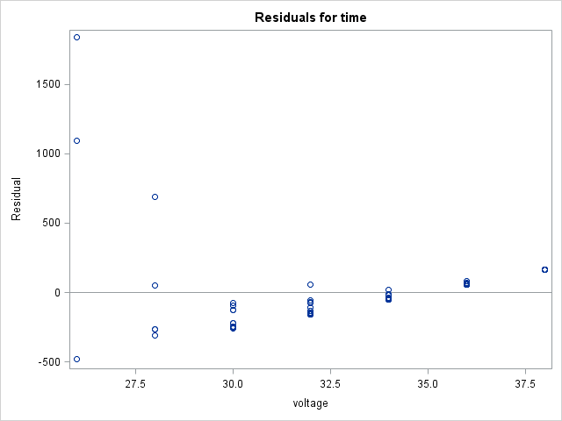
Insulation v. Voltage
Definite curvature, possibly non-constant variance as well

Slide 18
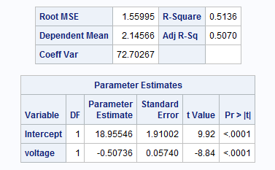
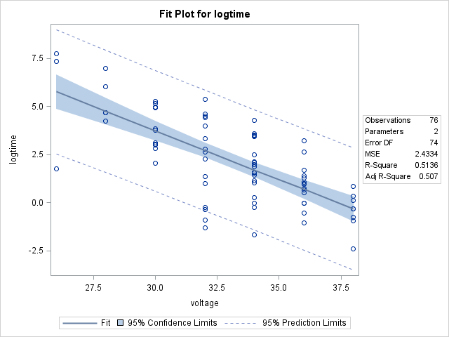
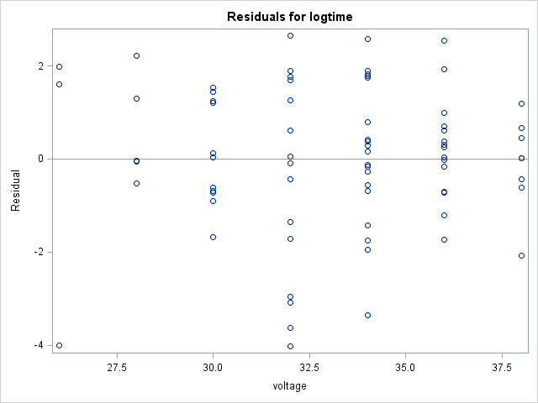
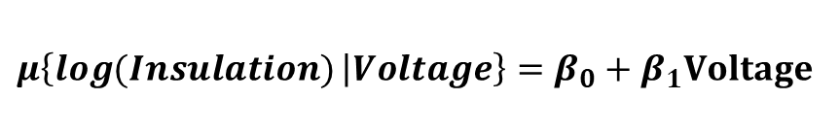
Try a Log-Linear Model
$$μ\left\{\log{(Insulation)} | Voltage\right\}=β_{0}+β_{1}Voltage$$
Variance looks more constant. What looks like smaller spread might just be fewer data points at those levels.
Linearity looks much better

Slide 19














Log Transforms: Log-Linear Transform Y to natural log of Y¹
See p. 216 in the Text
Fitted Model
Note for Development
$$\log\left(Y\right)=\log_{e}{(Y)}$$
$$\log\left(Median\left(Y\right)\right)=mean\left(\log\left(Y\right)\right)$$
${ a}^{\log_{a}{y}}=y$ for any $a>0$
$$μ\left\{\log\left(Y\right) | X\right\}=β_{0}+β_{1}\left(X\right)$$
$$log⁡(Median\left(Y | X\right))=β_{0}+β_{1}(X)$$
$$e^{log⁡(Median\left(Y | X\right))}=e^{β_{0}+β_{1}X}$$
$$Median\left(Y | X\right)=e^{β_{0}}e^{β_{1}X}$$
and $Median\left(Y | X+1\right)=e^{β_{0}}e^{β_{1}(X+1)}$
$$Median\left(Y | X+1\right)/ Median\left(Y | X\right)$$
$${=e}^{β_{0}}e^{β_{1}(X+1)}/e^{β_{0}}e^{β_{1}X}$$
$$Median\left(Y | X+1\right)/ Median\left(Y | X\right)$$
$${=e}^{β_{1}(X+1)}/e^{β_{1}X}$$
$$Median\left(Y | X+1\right)/ Median\left(Y | X\right)$$
$$={ e}^{β_{1}X}e^{β_{1}}/e^{β_{1}X}$$
$$Median\left(Y | X+1\right)/ Median\left(Y | X\right)$$
$${=e}^{β_{1}}$$
Interpretation: A one unit increase in X is associated with a multiplicative change of $e^{β_{1}}$ in Median(Y|X).
1. Note: We use a base of e for $e^{β_{1}}$ because the base on the log function was implied to be e. Note: e =~ 2.718
Other bases could used as well.

Slide 20
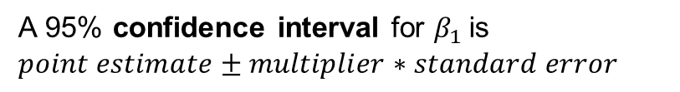
Interpretation: Log – Linear (see page 216 Text)
The data suggest each 1 kV increase in voltage is associated with a decrease in the median time to insulation breakdown by a factor of e^{-0.507 =} 0.6. That is, the median y at each value of x is only 0.6 of the median y at 1 less unit of x. In other words, a one unit increase in Voltage is associated with a 40% decrease in median time to breakdown. (y-0.6y = 0.4y)
It is estimated that voltage explains about 51.36% of the variation in breakdown time of this insulation fluid.
A 95% confidence interval for $β_{1}$is
$$point estimate±multiplier∗standard error$$
${\hat{β}}_{1}±t_{.975, 76−2}∗SE({\hat{β}}_{1}$)
-0.507 $±$ 1.99* 0.0574
-0.507 $±$ 0.1142
CI = (-0.621, -0.393)
A 95% CI for the multiplicative decrease in median time is:
(e^{-0.621}, e^{-0.393}) = (0.54, 0.68) ~ (-46%, -32%).

Slide 21
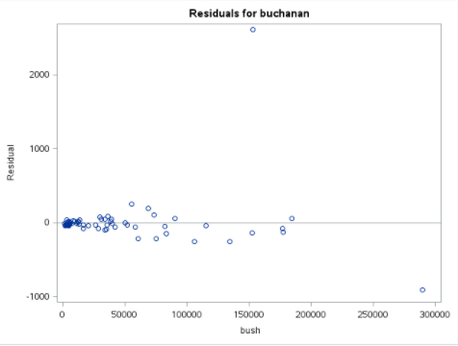
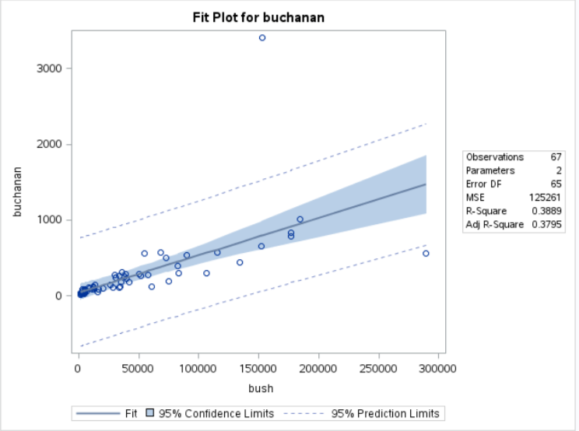
Another Model Vote counts for Bush vs. Buchanan in Florida counties Scatterplots
Palm Beach County
Palm Beach County
Bush 152,846
Angry Democratic voters in Palm Beach County complained that a confusing "butterfly" lay-out ballot caused them to accidently vote for the Reform Party candidate Pat Buchanan instead of Gore. Analyze using regression methods.

Slide 22
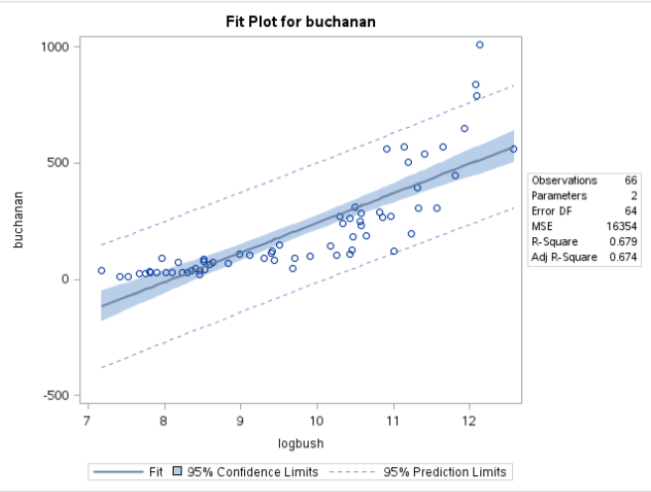
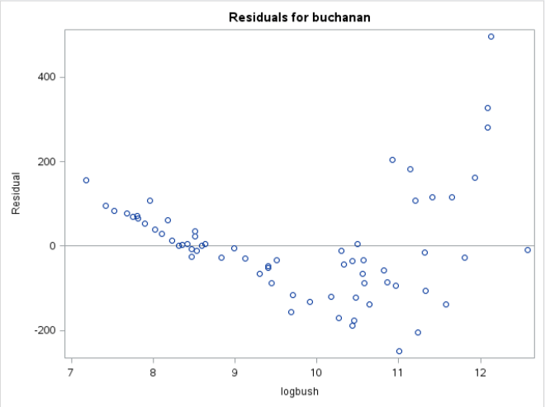
Residual Analysis Transformation to log of Bush votes
Curvature means non-random cloud: non-constant variance, non-linearity

Slide 23
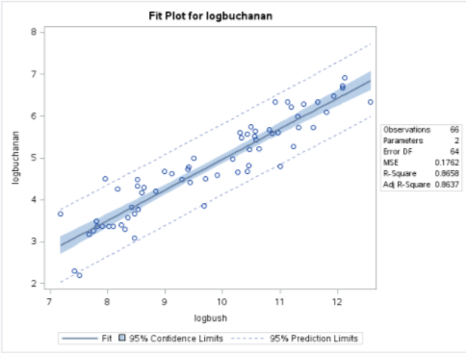
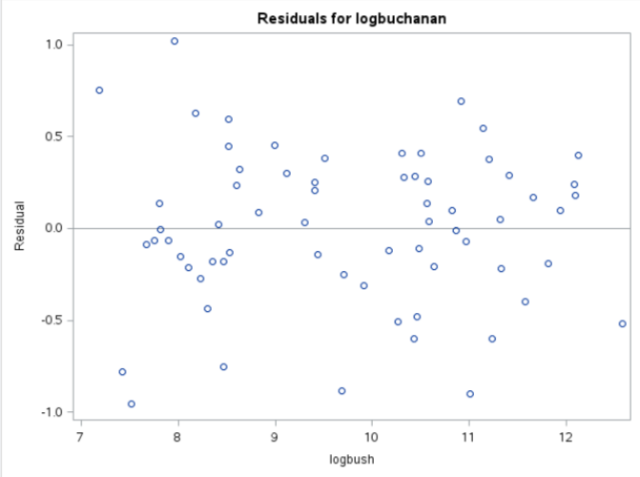
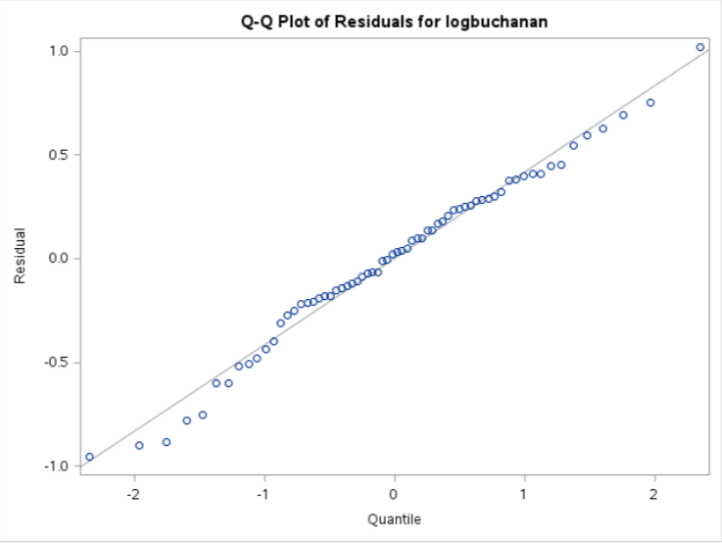
Residuals Analysis Transformation to log of Buchanan and log of Bush votes
Even scatter, linear trend, no curvature
Equal SD.
Residuals are normally distributed.
Linear

Slide 24
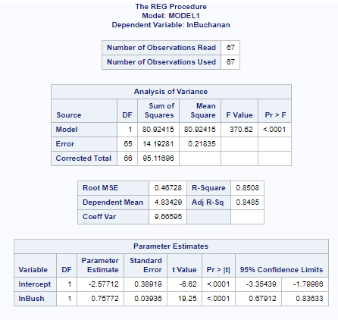
Regression Results – log-log model

Slide 25
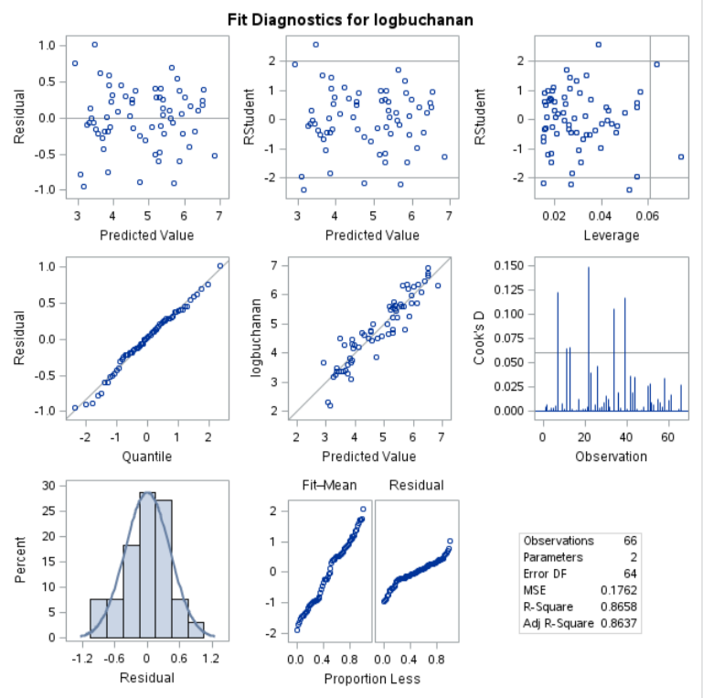


The Regression Panel

Slide 26
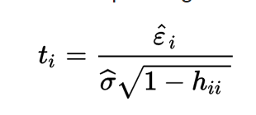
The Regression Panel
These are studentized residuals, which are essentially the residual divided by the standard deviation of the observations given X_{i}. We know that the residuals are assumed to be normally distributed; thus, for now, it is enough to know that observations with a studentized residual greater than 2 or less than -2 may be flagged as extreme values. Below is the formula for the studentized residual.
Here, h_{ii} is the “leverage” of the i^{th} observation. We will discuss “leverage” later.

Slide 27

Bush – Buchanan Convert from Log Prediction
Conf. Int.
Prediction
Conf. Int.
Mean
$$e_{i}$$
The actual value for Buchanan is 3,407 which is outside the 95% confidence limit for the prediction from the regression. This is highly unlikely, so conclude something irregular was going on.

Slide 28

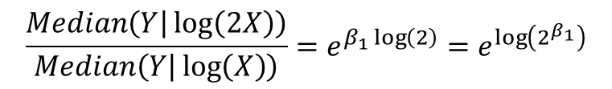
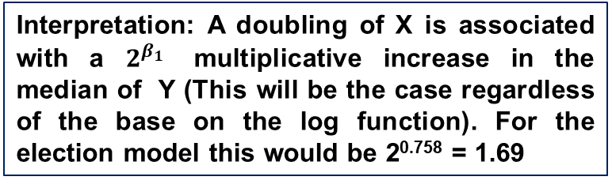
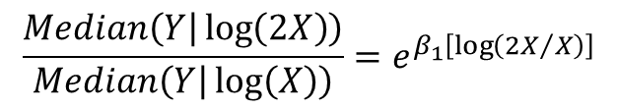




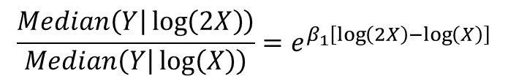

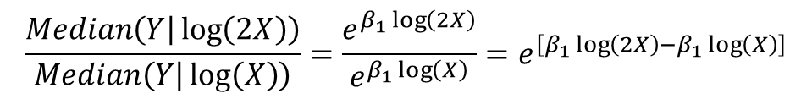
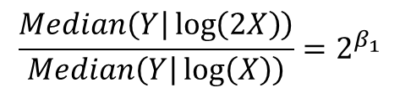
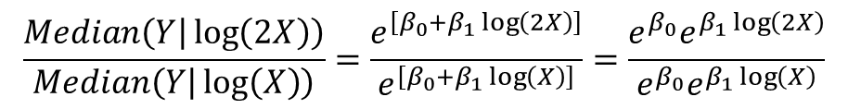
Interpretation Log-Log Model
$$μ\left\{\log\left(Y\right) | \log\left(X\right)\right\}=β_{0}+β_{1}\log\left(X\right)$$
Note for Derivation
$$\log\left(Median\left(Y | \log\left(X\right)\right)\right)=β_{0}+β_{1}\log\left(X\right)$$
*$\log\left(Median\left(Y\right)\right)=mean\left(\log\left(Y\right)\right)$
*$a^{\log_{a}{y}}=y$ for any $a>0$
$$e^{\log\left(Median\left(Y | \log\left(X\right)\right)\right)}=e^{\left[β_{0}+β_{1}\log\left(X\right)\right]}$$
$$Median\left(Y | \log\left(X\right)\right)=e^{\left[β_{0}+β_{1}\log\left(X\right)\right]}$$
and $Median\left(Y | \log\left(2X\right)\right)=e^{\left[β_{0}+β_{1}\log\left(2X\right)\right]}$
$$\frac{Median\left(Y | \log\left(2X\right)\right)}{Median\left(Y | \log\left(X\right)\right)}=\frac{e^{\left[β_{0}+β_{1}\log\left(2X\right)\right]}}{e^{\left[β_{0}+β_{1}\log\left(X\right)\right]}}=\frac{e^{β_{0}}e^{β_{1}\log\left(2X\right)}}{e^{β_{0}}e^{β_{1}\log\left(X\right)}}$$
$$\frac{Median\left(Y | \log\left(2X\right)\right)}{Median\left(Y | \log\left(X\right)\right)}=\frac{e^{β_{1}\log\left(2X\right)}}{e^{β_{1}\log\left(X\right)}}=e^{\left[β_{1}\log\left(2X\right)−β_{1}\log\left(X\right)\right]}$$
$$\frac{Median\left(Y | \log\left(2X\right)\right)}{Median\left(Y | \log\left(X\right)\right)}=e^{β_{1}\left[\log\left(2X\right)−\log\left(X\right)\right]}$$
$$\frac{Median\left(Y | \log\left(2X\right)\right)}{Median\left(Y | \log\left(X\right)\right)}=e^{β_{1}\left[\log\left({2X}/X\right)\right]}$$
$$\frac{Median\left(Y | \log\left(2X\right)\right)}{Median\left(Y | \log\left(X\right)\right)}=e^{β_{1}\log\left(2\right)}=e^{\log\left(2^{β_{1}}\right)}$$
Interpretation: A doubling of X is associated with a $2^{β_{1}}$ multiplicative increase in the median of Y (This will be the case regardless of the base on the log function). For the election model this would be 2^{0.758} = 1.69
$$\frac{Median\left(Y | \log\left(2X\right)\right)}{Median\left(Y | \log\left(X\right)\right)}=2^{β_{1}}$$

Slide 29
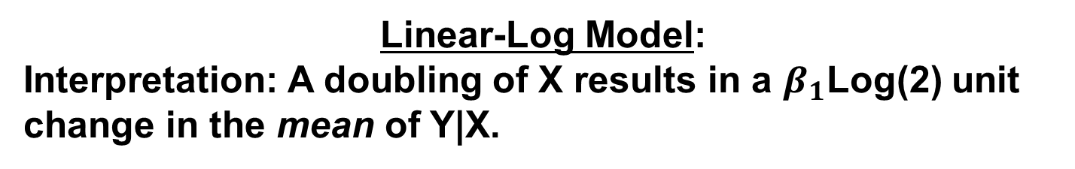

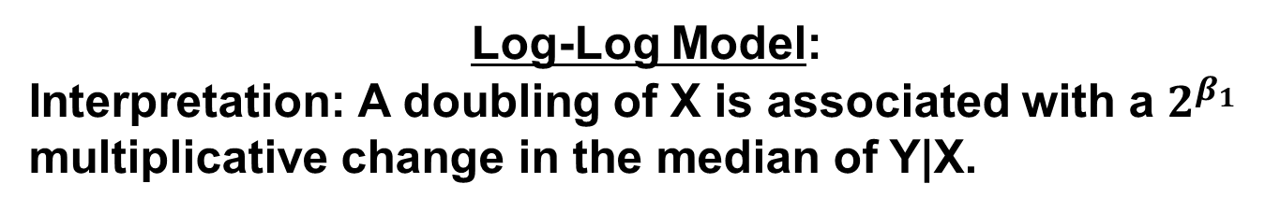
Summary of Interpretation of Log Models
Linear-Log Model:
Interpretation: A doubling of X results in a $β_{1}$Log(2) unit change in the mean of Y|X.
Log-Linear Model:
Interpretation: A one unit increase in X is associated with a multiplicative change of $e^{β_{1}}$ in median of Y|X.
Log-Log Model:
Interpretation: A doubling of X is associated with a $2^{β_{1}}$ multiplicative change in the median of Y|X.

Slide 30
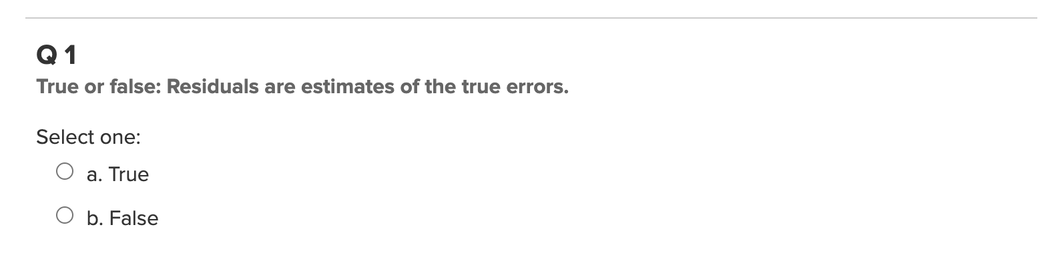
Quick Quiz Question 1

Slide 31
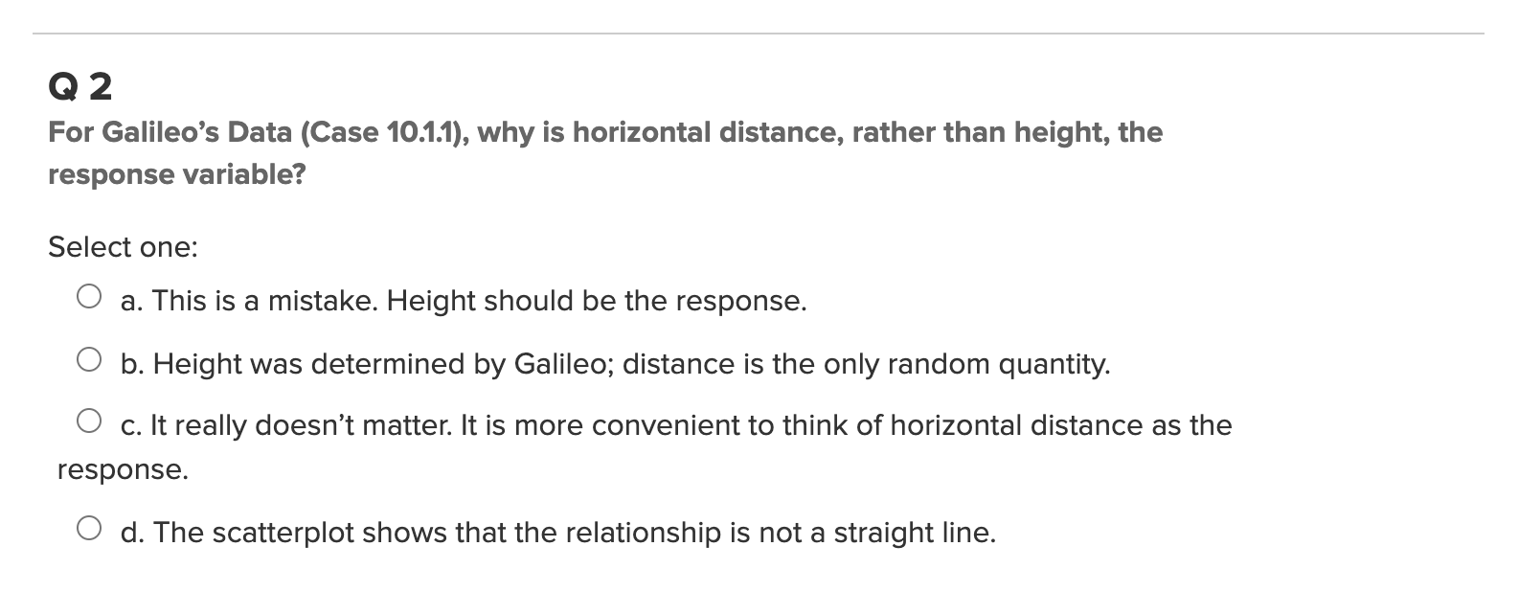
Quick Quiz Question 2

Slide 32
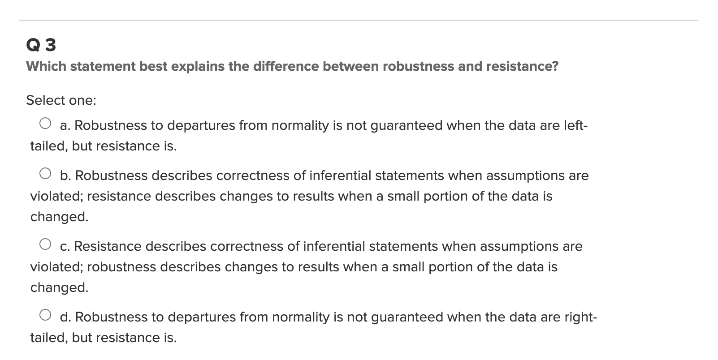
Quick Quiz Question 3

Slide 33
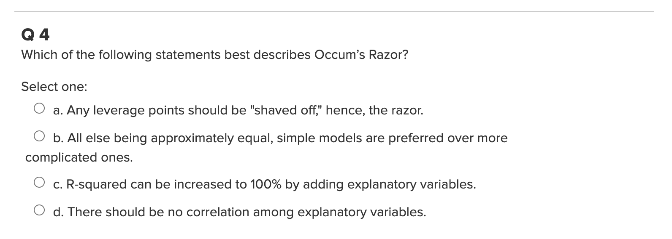
Quick Quiz Question 4

Slide 34
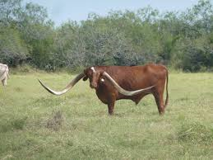
Exercise 1: Meat Processing and pH
A certain kind of meat processing may begin once the pH in postmortem muscle of a steer carcass decreases to 6.0 from a pH at time of slaughter of around 7.0 to 7.2. It is not practical to monitor the pH decline for each animal. So, an value of the time after slaughter at which the pH reaches 6.0. To find this time, 10 steer carcasses were assigned to be measured for pH at one of five times after slaughter.
Conduct a complete regression analysis of the meat processing data to develop a model to evaluate at what time the pH level reaches 6.0.
Evaluate residuals and make any necessary transformations (There is a transformation that improves the curvature in the plot of residuals).
Interpret the change in the time prediction with a doubling of pH level (see page 217 in the text).
Manually calculate the confidence interval for the regression slope & confirm with program output.
Report confidence intervals for pH from your model for a time value you calculated in question 1 above and manually confirm the interval reported by the program output.
Prepare a clear write-up arguing why the model you have developed should be used.

Slide 35
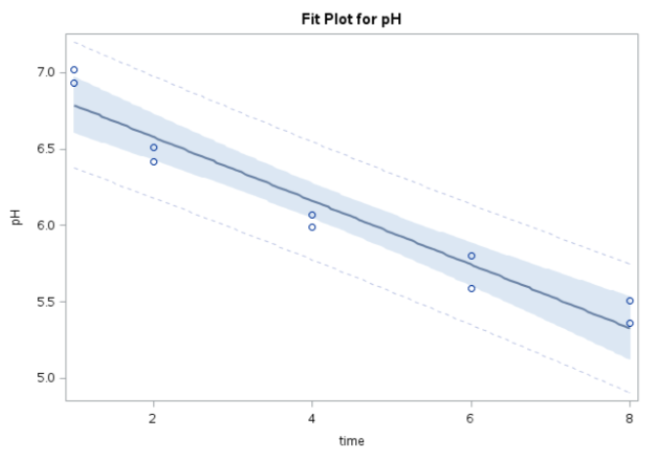
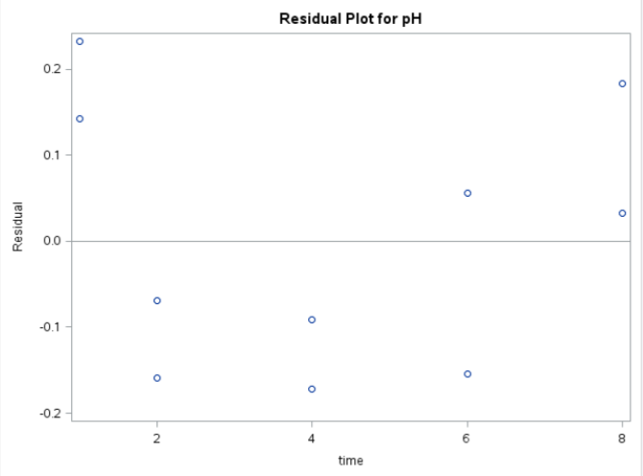

Exercise 1.2: No Transforms: Linear
$$\hat{Y}={\hat{β}}_{0}+⁡{\hat{β}}_{1}\left(X\right)$$
Curvature likely, so let's transform

Slide 36
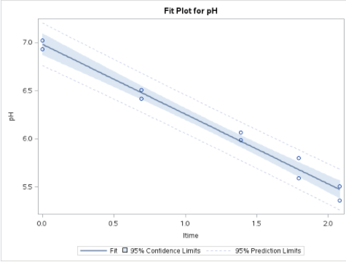
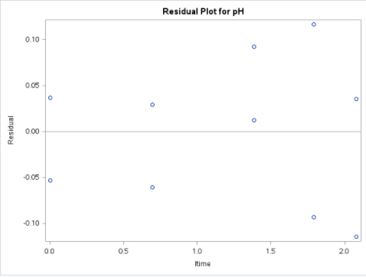


Exercise 1.1, 1.2 (: Log Transforms: Linear-Log)
$$\hat{Y}={\hat{β}}_{0}+{\hat{β}}_{1}log\left(X\right)$$
Linearity much better
Random cloud of residuals

Slide 37


Exercise 1.3: Interpretation: Linear – Log
Interpretation of $β_{1}$ estimate
$μ\left\{Y | \log\left(2X\right)\right\}−μ\left\{Y | \log\left(X\right)\right\}=β_{1}\log\left(2\right)$
The data suggest that the predicted mean pH changes by (-0.7257)log(2) = -0.503 for each doubling of time.
It is estimated that time explains about 98.23% of the variation in pH of steer carcasses.
A 95% confidence interval for $β_{1}$is
$$point estimate±multiplier∗standard error$$
${\hat{β}}_{1}±t_{.975, 10−2}∗SE({\hat{β}}_{1}$)
-0.7257 $±$ 2.31* 0.03443
-0.7257 $±$ 0.0795
(-0.8052, -0.6462)
A 95% confidence interval for $β_{1}Log\left(2\right)$ (or for the change in mean pH for each doubling of time) is:
[-0.805log(2), -0.646log(2)] = (-0.558, -0.448).

Slide 38


Exercise 1.4,1.5: More on confidence Intervals
Parameter Estimates
Variable | Label | DF | Parameter Estimate | Standard Error | t Value | Pr > |t| | 95% Confidence Limits
Intercept | Intercept | 1 | 6.98363 | 0.04853 | 143.90 | <.0001 | 6.87171 | 7.09554
logTime |  | 1 | -0.72566 | 0.03443 | -21.08 | <.0001 | -0.80505 | -0.64627
Root MSE | 0.08226 | R-Square | 0.9823
Dependent Mean | 6.12000 | Adj R-Sq | 0.9801
Coeff Var | 1.34411
Regression Slope CI df for t = 8
LB = -0.72566 – 0.03443(2.306) = -0.80505
UB = -0.72566 + 0.03443(2.306) = -0.64627
95% CL Predict
$$SE\left(\text{Y}\text{̅}\text{i}\text{|}\text{Xi}\right)=\hat{σ}\sqrt{1+\frac{1}{n}+\frac{{\left(X_{i}−\overline{x}\right)}^{2}}{\left(n−1\right){s_{x}}^{2}}}$$
$\hat{σ}=0.0826;n=10;X_{i}=3.88;\overline{x}=4.2$;
$SE\left(\text{Y}\text{̅}\text{i}\text{|}\text{Xi}\right)=0.086$4
LB = 6 - 0.0864(2.306) = 5.80
UB = 6 + 0.0864(2.306) = 6.19

Slide 39

Summary
Assumptions Regression Modeling
Normality of error terms
Homoskedasticity
Influence of Outliers
Taking logs of variables may help meeting model assumptions for better coefficient estimates
log X model
log Y model
log X, log Y model
Interpretation of log models for change in X
log X model: A doubling of X results in β₁log2 change in Y
log Y model: A one unit increase in X is associated with a multiplicative change of $e^{β_{1}}$ in the Median of Y.
log X, log Y model: A doubling of X is associated with a $2^{β_{1}}$ multiplicative increase in the median of Y
In models with log Y be sure to take antilogs when reporting results

